Slide 1

Customer Insights
Data Quality issue and its cleaning
Data Preparation and Load
Key Insights from data with visualization
Recommendations

Slide 2
Data quality issues and its cleaning
The data set contains two years of customer’s transactions data.
In the data, there were different anomalies like blank values, incorrect data type, negative values etc.
Below columns had incorrect values for which the respective actions were taken to correct and clean the data.
Country- Filtered out unspecified values.
Customer ID- Filtered out blank values.
Quantity – Removed negative values based on condition values>0.
StockCode - Filtered non numeric values from both, then applied below formula to remove the extra alphabet from the end since StockCode is a 5-digit integral number uniquely assigned to each distinct product.
=IF(ISNUMBER(VALUE(LEFT(B2,5))),LEFT(B2,5),"")

Slide 3
Data Preparation and Load
After cleaning the data, merged both the sheets into single data.
Added few columns to find insights for the data like
Sales = Product of Quantity and Price
Year = Extracted year from InvoiceDate column with the help of year function.
Month = Extracted year from InvoiceDate column with the help of Month function.
Post data transformation and preparation, loaded the file to MS SQL Server in the table Customers.

Slide 4
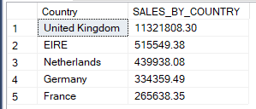
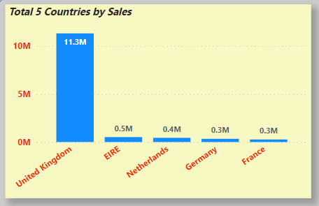
Key Insights from data with visualization
1. Top 5 Countries by Sales
SELECT TOP 5 Country,
SUM(CAST(SALES AS DECIMAL(10,2))) AS SALES_BY_COUNTRY
FROM CUSTOMERS
GROUP BY Country
ORDER BY SALES_BY_COUNTRY DESC;

Slide 5
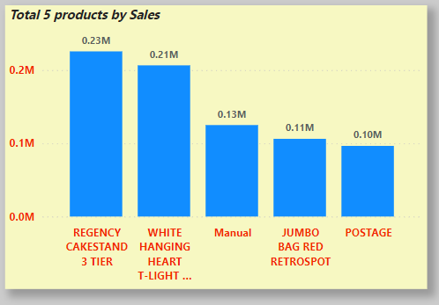
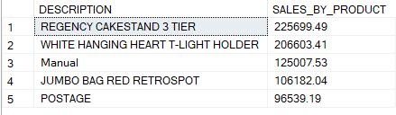
2. Top 5 Product by Sales
SELECT TOP 5 DESCRIPTION,
SUM(CAST(SALES AS DECIMAL(10,2))) AS SALES_BY_PRODUCT
FROM CUSTOMERS
GROUP BY DESCRIPTION
ORDER BY SALES_BY_PRODUCT DESC;

Slide 6
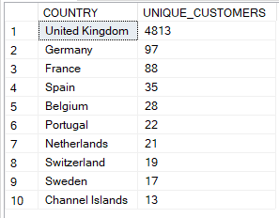

3. Top 10 countries by unique customers count
SELECT TOP 10 COUNTRY, COUNT(DISTINCT CUSTOMER_ID) AS UNIQUE_CUSTOMERS
FROM CUSTOMERS
GROUP BY COUNTRY
ORDER BY UNIQUE_CUSTOMERS DESC;
4. Year on Year Sales Growth
WITH YOY_GROWTH AS(
SELECT YEAR AS YEAR, SUM(CAST(SALES AS DECIMAL(10,2))) AS CURRENT_SALES
FROM CUSTOMERS
GROUP BY YEAR
)
, YOY_GROWTH1 AS(
SELECT *,
LAG(CURRENT_SALES,1,CURRENT_SALES) OVER (ORDER BY YEAR) AS PREVIOUS_YEAR_SALES
FROM YOY_GROWTH
)
SELECT *,(CURRENT_SALES-PREVIOUS_YEAR_SALES)*100/PREVIOUS_YEAR_SALES AS SALES_YOY_GROWTH
FROM YOY_GROWTH1;

Slide 7
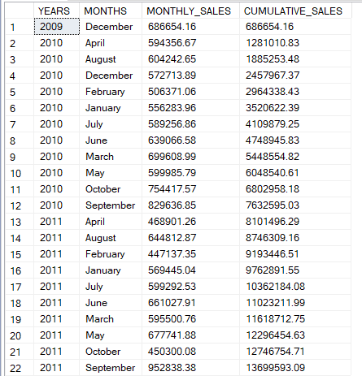
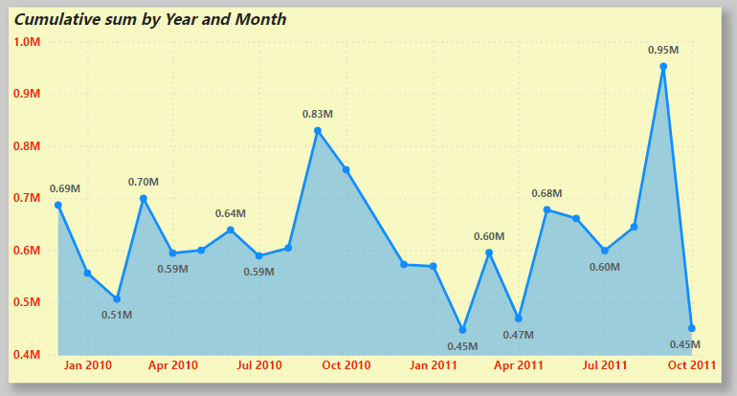
5. Cumulative or Running sum of sales by Month for each Year
WITH CTE AS(
SELECT YEAR AS YEARS,DATENAME(MONTH,INVOICEDATE) AS MONTHS, SUM(CAST(SALES AS DECIMAL(10,2))) AS MONTHLY_SALES
FROM CUSTOMERS
GROUP BY YEAR,DATENAME(MONTH,InvoiceDate)
)
SELECT *,SUM(MONTHLY_SALES) OVER (ORDER BY YEARS,MONTHS) AS CUMULATIVE_SALES
FROM CTE

Slide 8

6. Count of repeat customers for each year
WITH CTE AS
(SELECT CUSTOMER_ID, MIN(YEAR) AS FIRST_YEAR
FROM CUSTOMERS GROUP BY CUSTOMER_ID)
SELECT C.YEAR,
SUM(CASE WHEN C.YEAR=CT.FIRST_YEAR THEN 1 ELSE 0 END) AS NEW_CUSTOMERS,
SUM(CASE WHEN C.YEAR!=CT.FIRST_YEAR THEN 1 ELSE 0 END) AS REPEAT_CUSTOMERS
FROM CUSTOMERS C JOIN CTE CT
ON C.CUSTOMER_ID=CT.CUSTOMER_ID
GROUP BY C.YEAR
ORDER BY C.YEAR;

Slide 9
Recommendations
Based upon the insights from the previous slides,
I would like to suggest few points which can be helpful for the business growth.
Our insights suggests that we’re doing exceptionally well in United Kingdom country with respect to sales but there are few more countries where potential growth is observed like EIRE, Netherlands, Germany and France. So we should focus on expansion of business in other countries as well.
In the year 2010, there was significant sales growth but it was reduced in 2011. For an exponential growth, our sales should show positive growth year on year so we need to figure out the factors affecting the sales.
With respect to previous point, we have one more insight which shows cumulative sum by months which can help us to identify which month contributed the most and least in the year 2010.
One key thing to note is we’re maintaining good amount of repeat customers which shows customer’s trust on the company.

